Slide 1








Policy Priority Inference for Kenya:
Data Assessment & Use Case
Dr Daniele Guariso (The Alan Turing Institute, London, UK)

Slide 2




Project introduction
Lay the foundations for deploying the Policy Priority Inference (PPI) framework in Kenya
International cross-sectoral collaboration: KNBS, JKUAT, IDS, ATI
Data assessment, collection and compilation
Development of a PPI use case

Slide 3



Policy Priority Inference (PPI)
A computational tool (ABM) to model the link between government expenditure and policy outcomes
It models the complex (and imperfect) dynamics of the policymaking process
It considers the interdependent and multidimensional nature of development

Slide 4











The complexity of policy prioritisation
outcomes
inefficiency

Slide 5

Challenges in multidimensional impact evaluation
How does public spending impact development indicators?
How to account for complex interdependencies?
How do governments establish policy priorities (budget-wise)?
How can governments align to specific agendas (e.g. SDGs)?
How can we use coarse-grained data?
PPI tries to overcome empirical challenges that econometrics and machine learning cannot handle with currently existing data

Slide 6

A dynamical political economy game
Micro behaviours
Macro dynamics
Enact policies
Learning
Adaptability
Public officials
Conflicting incentives
Divert funds
Dynamical game
Misaligned objectives
Central authority
Foster development
Network of interdependencies

Slide 7


The data are far from perfect
Fiscal data
Spending classification
Outcome indicators
Total
?

Slide 8
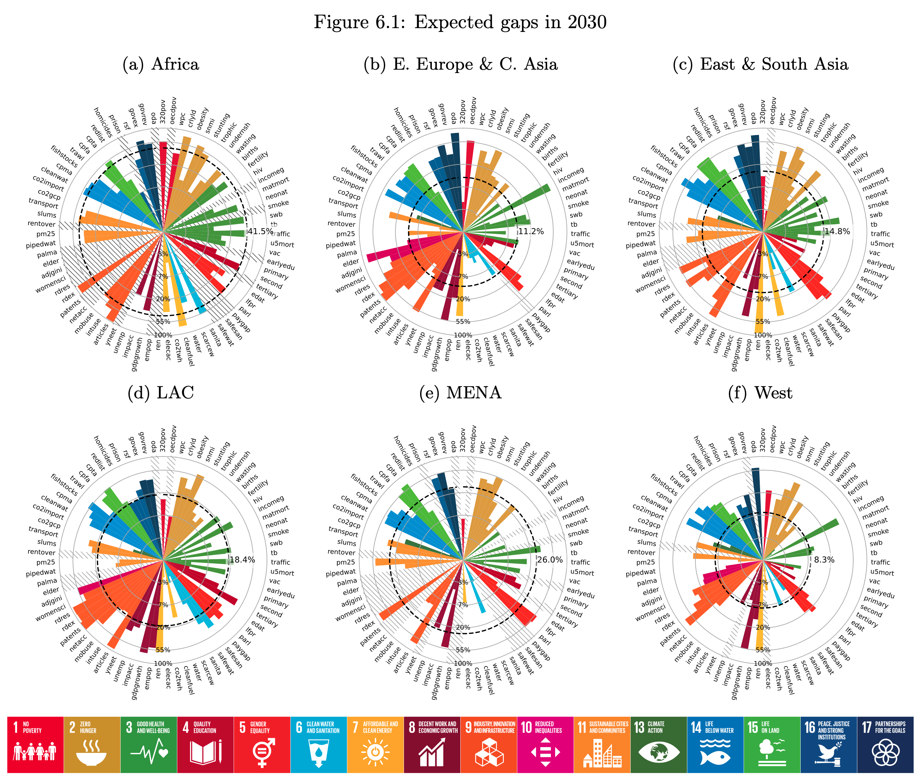
The feasibility of sustainable development

Slide 9
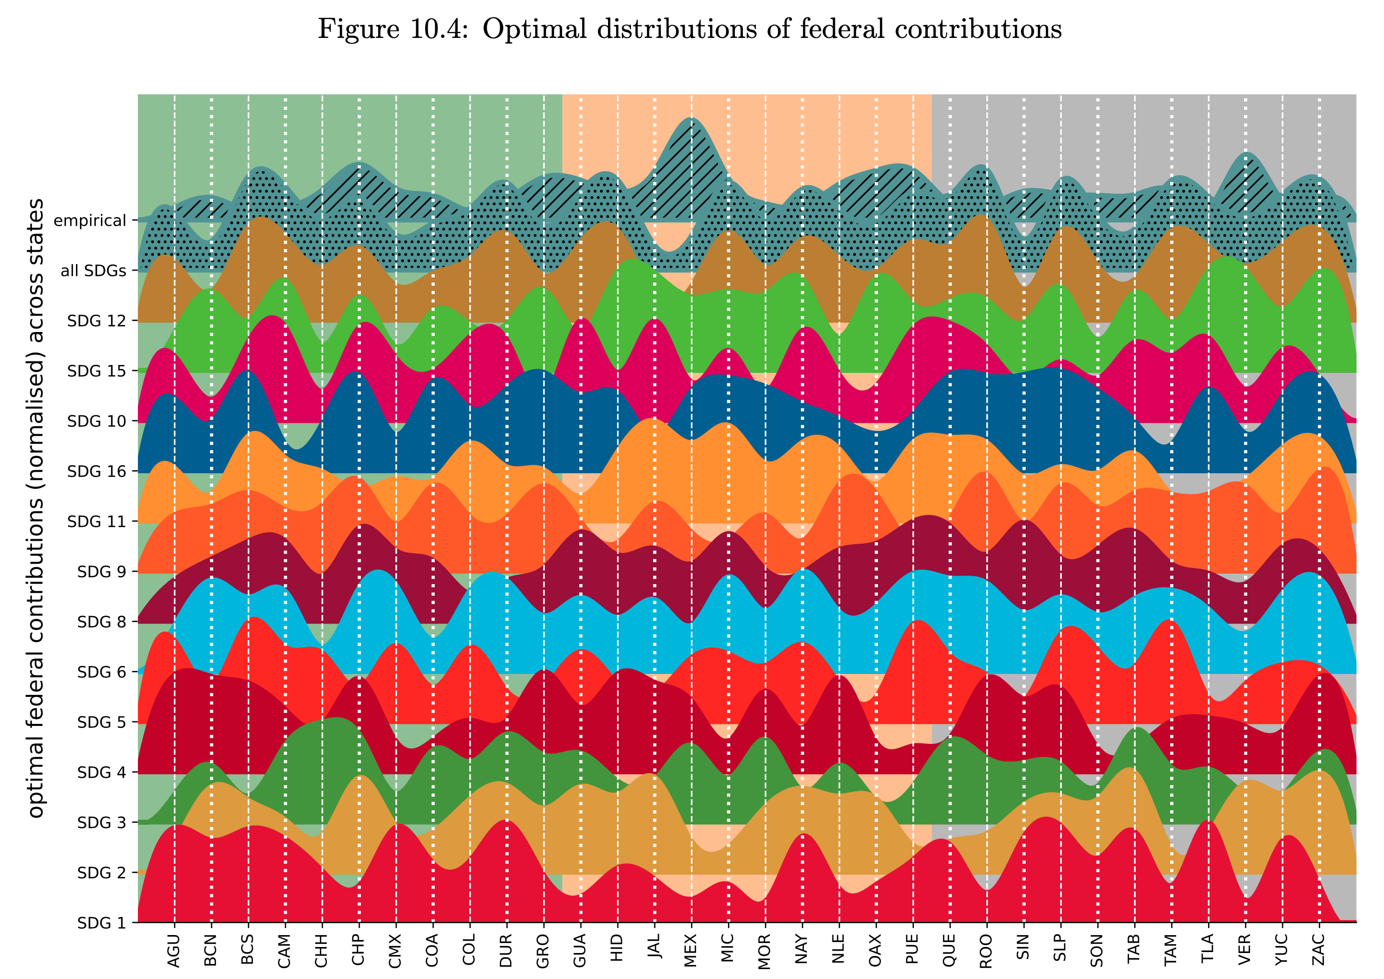
Subnational development and fiscal federalism

Slide 10
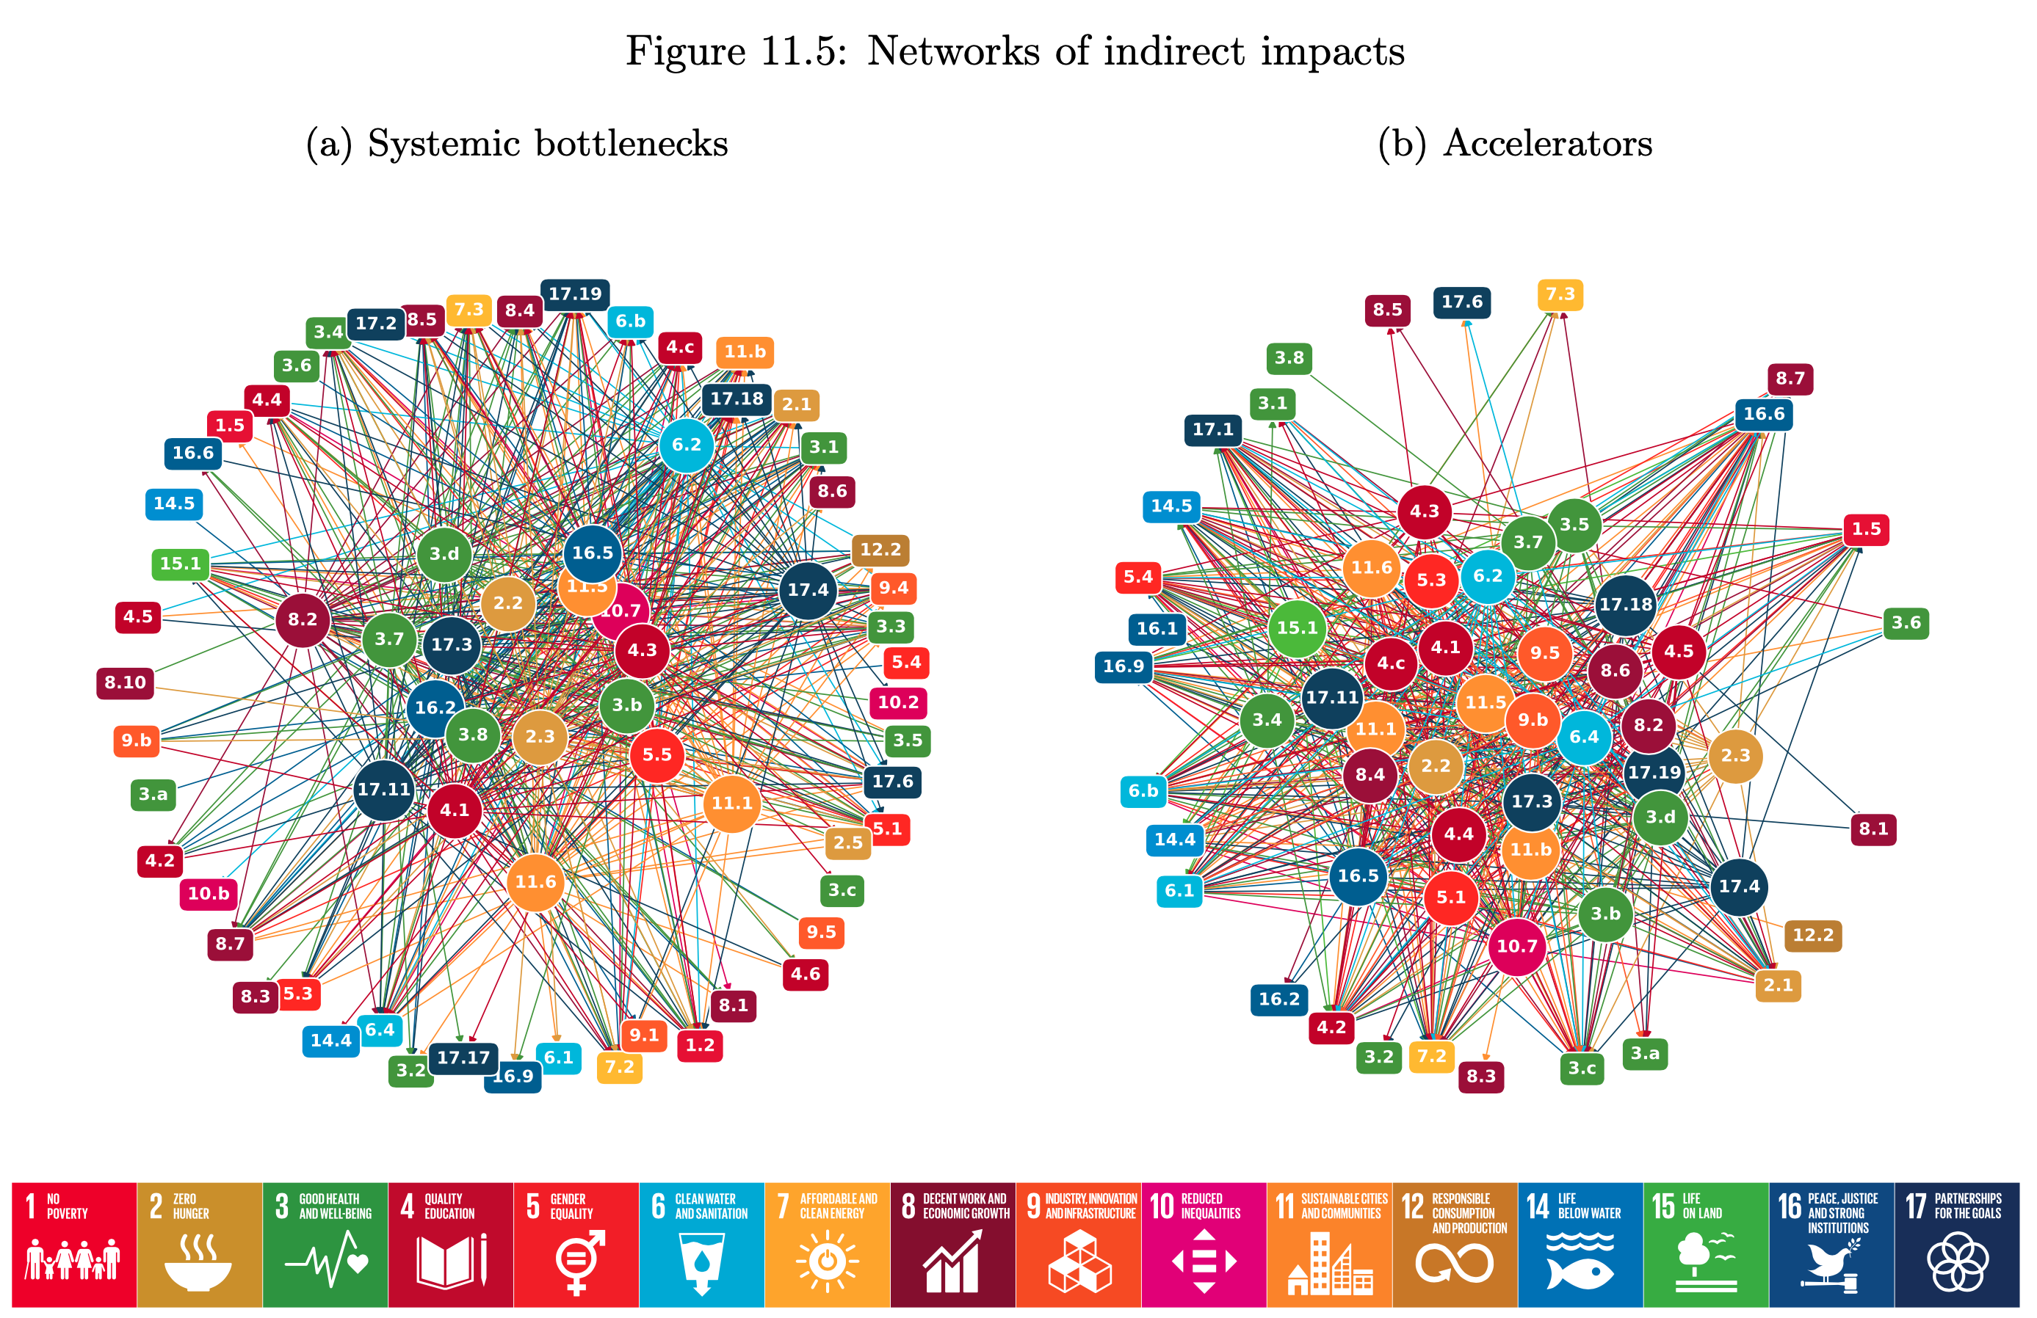
Accelerators and systemic bottlenecks

Slide 11
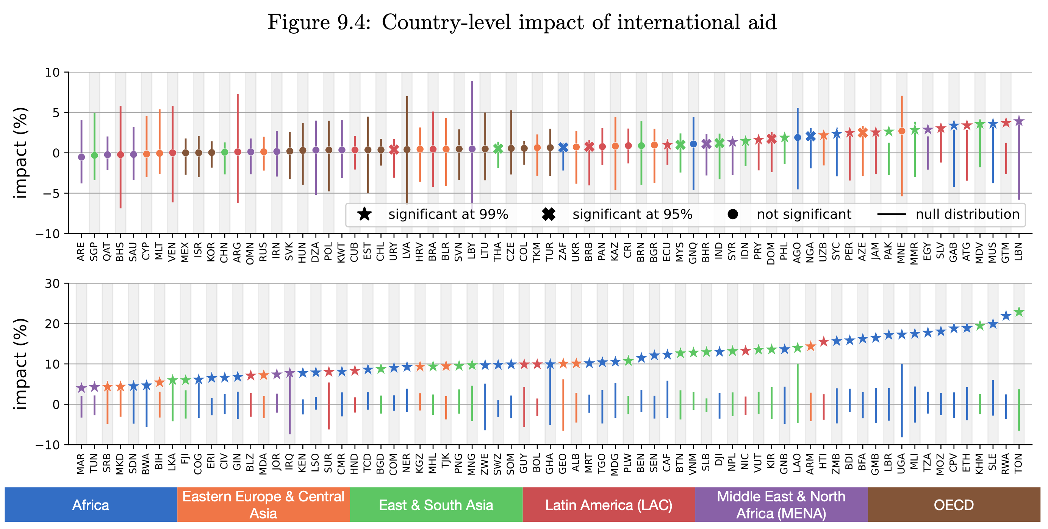
The impact of international aid

Slide 12
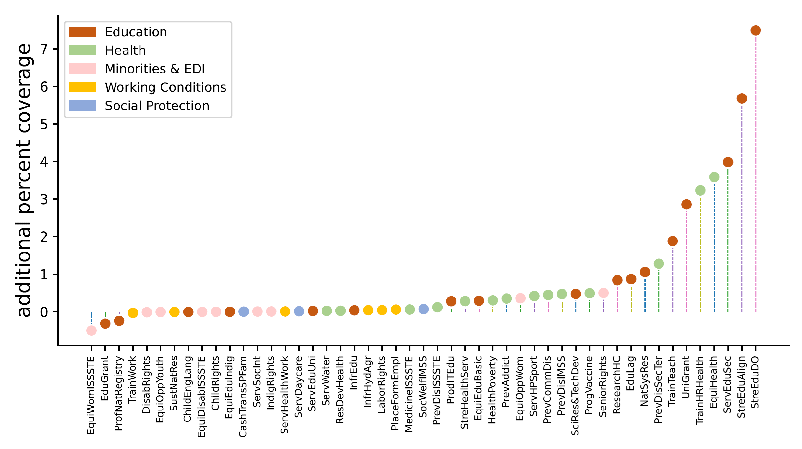
Social programme sensitivity
Additional percent coverage due to a 10% yearly increase in average baseline budget

Slide 13





























Everyone Loves PPI!
International, national, and sub-national collaborations!
Independent adoptions

Slide 14
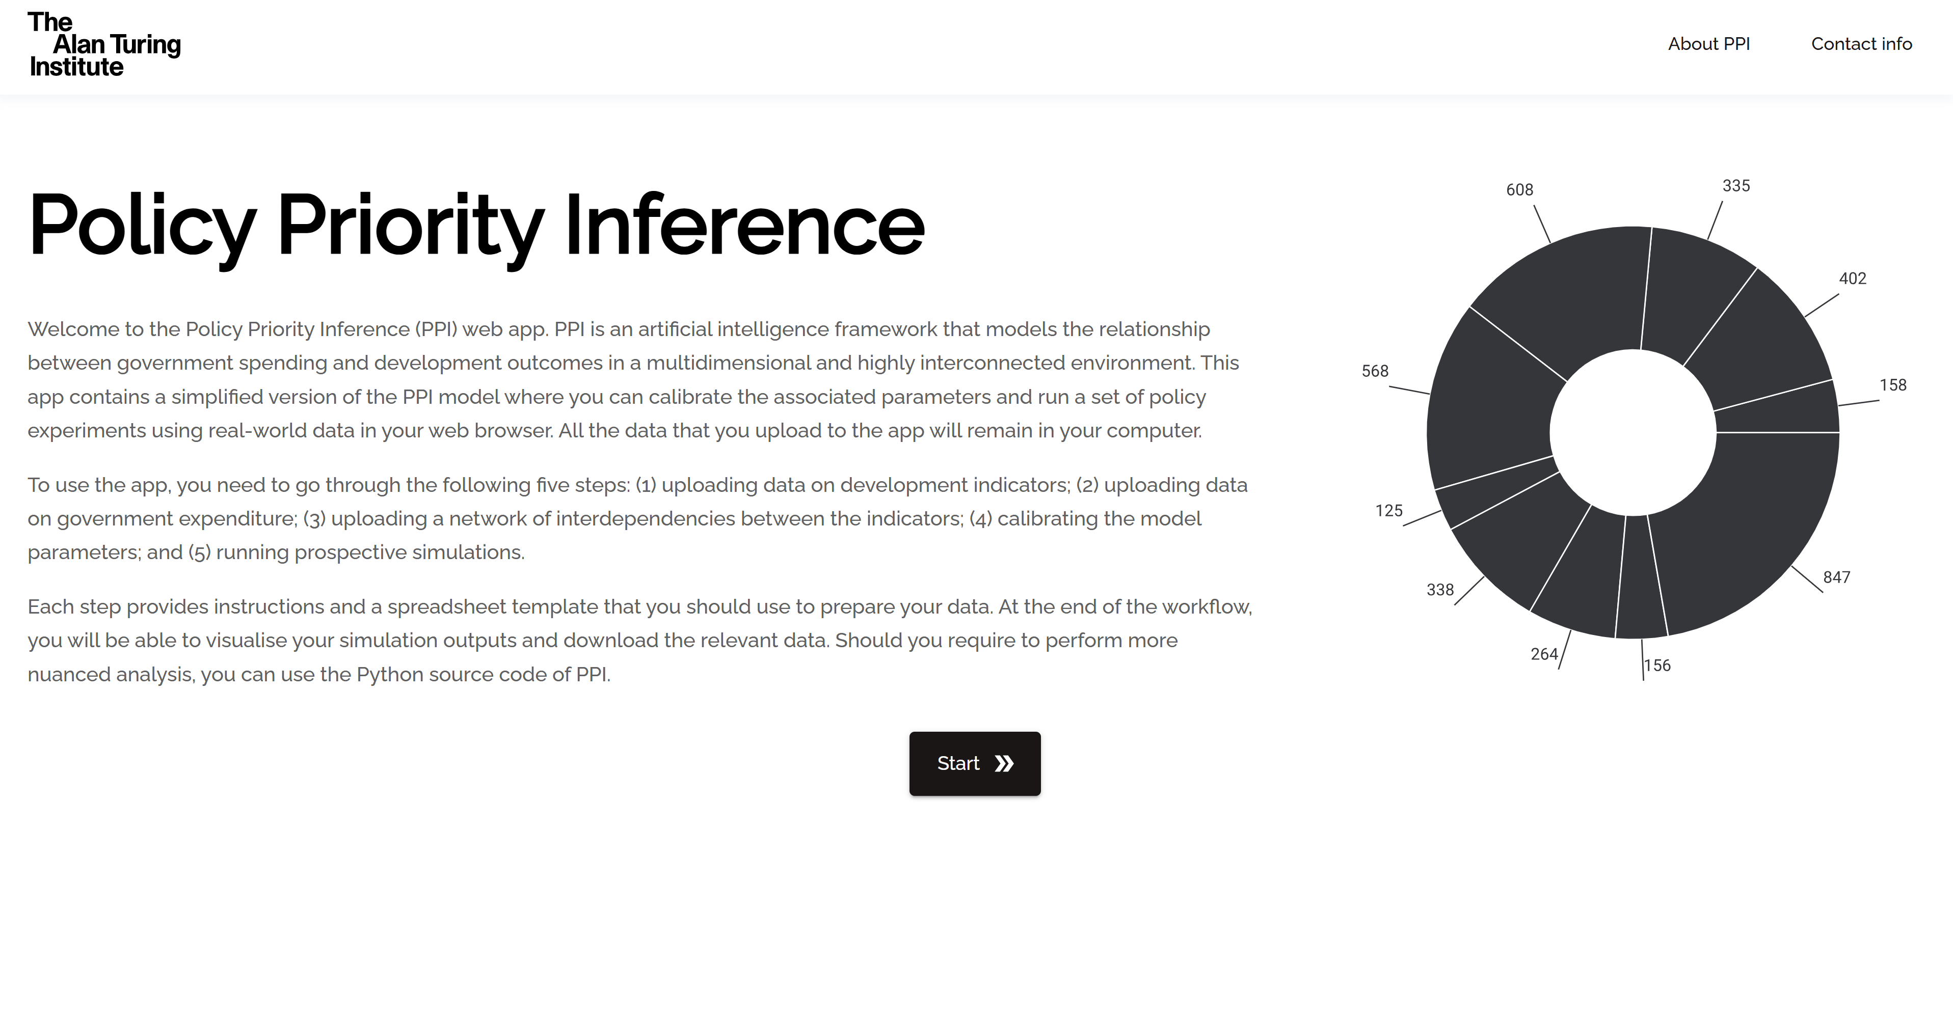
The PPI web app

Slide 15





Scoping PPI data requirements in Kenya
Fiscal data
Spending classification
Policy outcomes
Budget-to-indicator mapping
RA: Cleaning and assessing development indicators
Supervision: Dr Lawrence Nderu

Slide 16

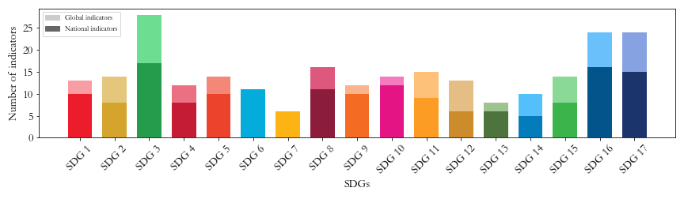
Data assessment: Development indicators (I)
Kenyan National SDGs Indicator Framework (NIF)
168 indicators out of the 248 official ones (67.7%)

Slide 17

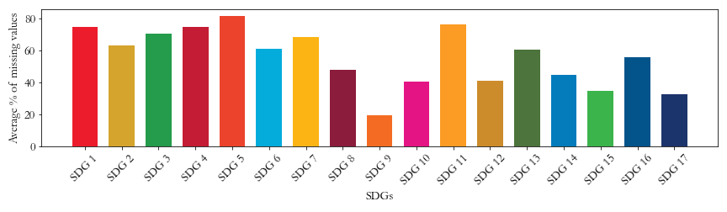
Data assessment: Development indicators (II)
Substantial data gaps:
The average percentage of missing values is 62.4%
Only around 50% of the indicators have more than two observations (2009/2014 - 2023)

Slide 18

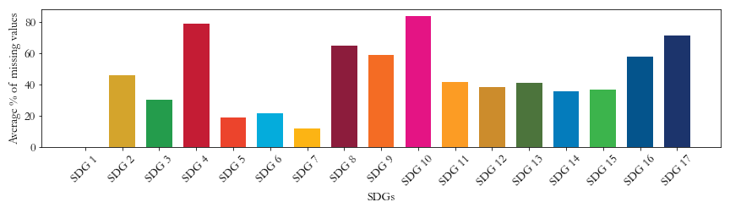
Data assessment: Development indicators (III)
Comparison: 2024 Sustainable Development Report (SDR)
The average percentage of missing values is 44.1%
83% of the indicators have more than 2 data points (2000 – 2024)

Slide 19





Data assessment: Development indicators (IV)
Key challenges identified for NIF:
Data Gaps: About one-third (32.3%) of the indicators are not tracked
Limited Capacity: Lack of technical expertise to compute indicators
Financial Constraints: Limited funding constraints regular data collection
Weak Coordination: Weak coordination within the National Statistical System affects KNBS availability of data sources

Slide 20


Data assessment: Public spending (I)
Open information on public spending published in the KNBS Economic Survey
Expenditure categorized according to the Classification of the functions of government (COFOG) system
Aggregate classification at COFOG 3/4 digits: 28 categories
Need for more granular classification

Slide 21




Data assessment: Public spending (II)
Moving to COFOG 5 digits:
Team of 5 KNBS technical experts
Information sourced from the Integrated Financial Management Information System (IFMIS)
Classification of (sub) programmes through a 3-level process:
Data extraction
Cross-checking
Final validation and approval

Slide 22


Data assessment: Public spending (III)
From 28 to 109 expenditure categories!
Key challenges identified:
Source data not sufficiently granular
Labour intensive
Time consuming
Text analysis and AI can help!

Slide 23


Data assessment: Budget-to-indicator mapping (I)
No existing mapping between budget lines and development outcomes
Build a mapping between COFOG categories and SDG targets
COFOG 5-digit
SDG targets
4.1: Ensure that all youth complete free, equitable and quality primary and secondary education
70912: Primary Education
…
4.6: Ensure that all youth achieve literacy and numeracy
…

Slide 24
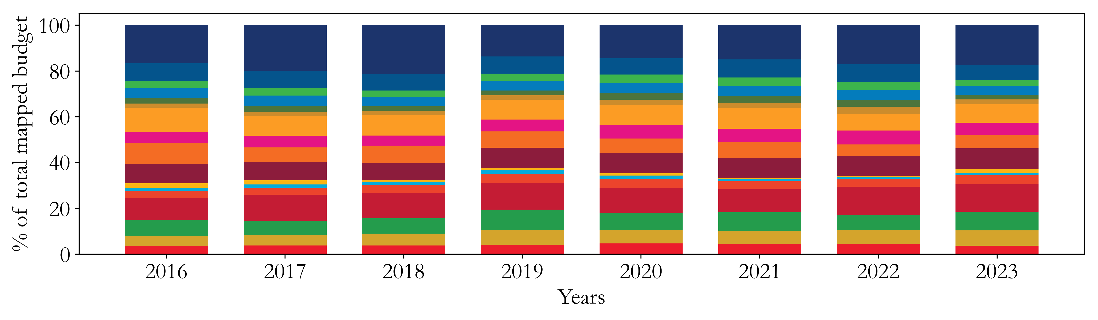
Data assessment: Budget-to-indicator mapping (II)
Monitoring public spending toward the SDGs:
Most funded: SDG 17 (~16.9%)
Less funded: SDG 7 (~1.15%)

Slide 25
Data assessment: Budget-to-indicator mapping (III)
Preliminary budget-to-SDGs mapping for Kenya
Key challenges identified:
Labour intensive
Time consuming
Partial alignment
Subjective classification
Text analysis and AI can help!

Slide 26

PPI use case: Kenya in 2030
PPI use case: Simulate the trends of development indicators to 2030 given current budget
Budget data: Newly compiled KNBS data (2016-2023)
Indicator data: 71 SDR indicators covering 44 SDG targets (2016-2023)

Slide 27
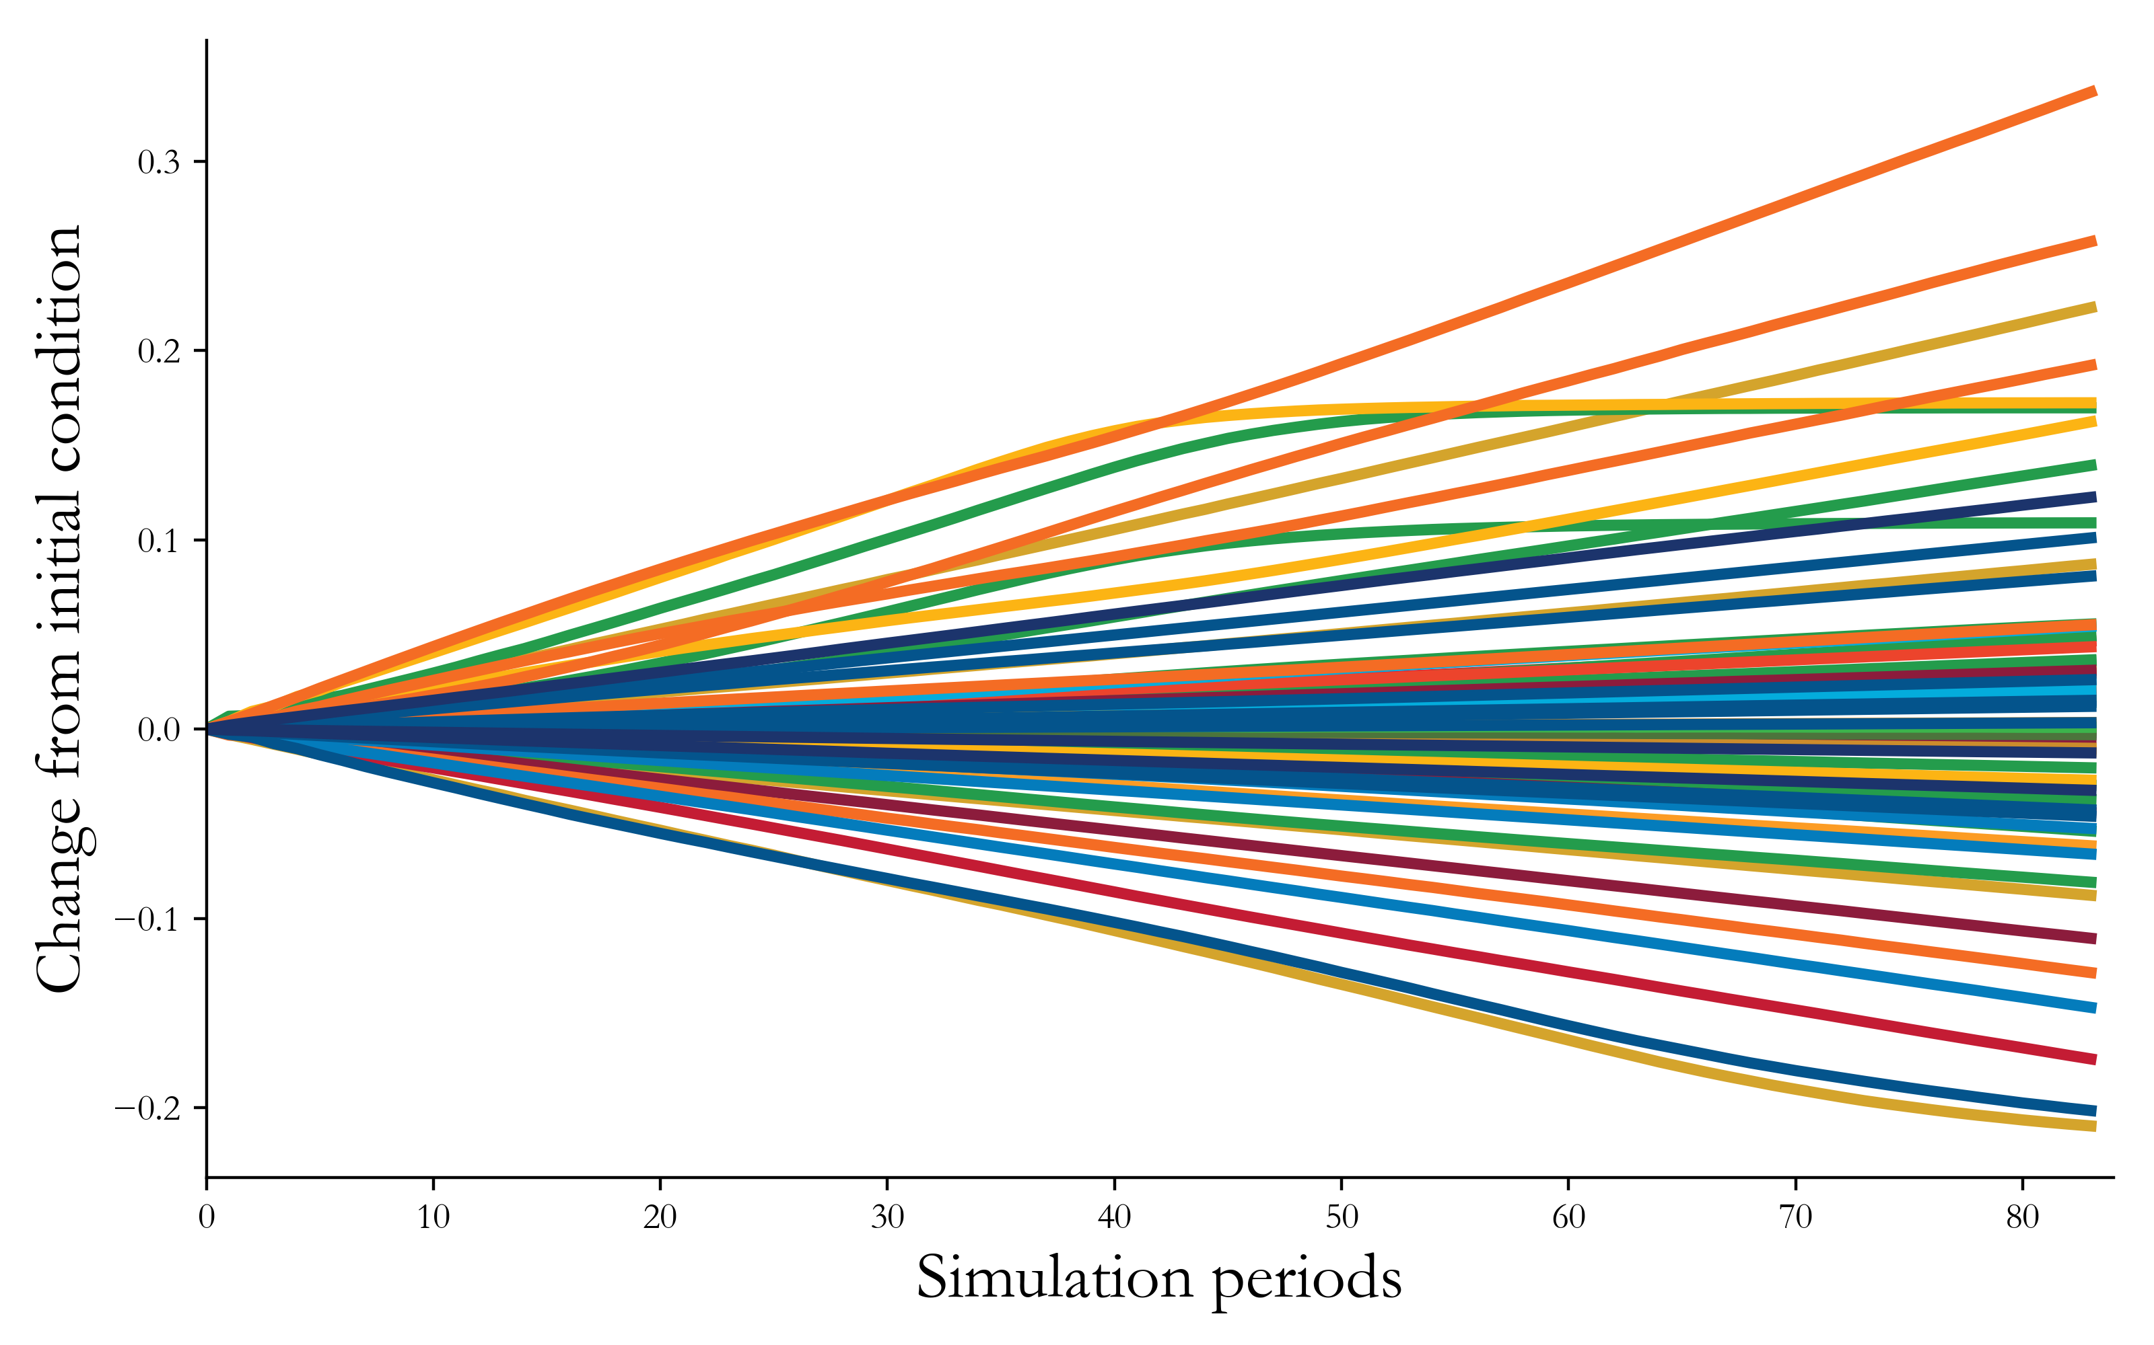
PPI use case: Prospective simulation
Heterogeneous trends across the indicators:
Best performing: Internet use (SDG 9) and mobile subscriptions (SDG 9)
Worst performing: Prevalence of undernourishment (SDG 2) and Press Freedom Index (SDG 16)

Slide 28

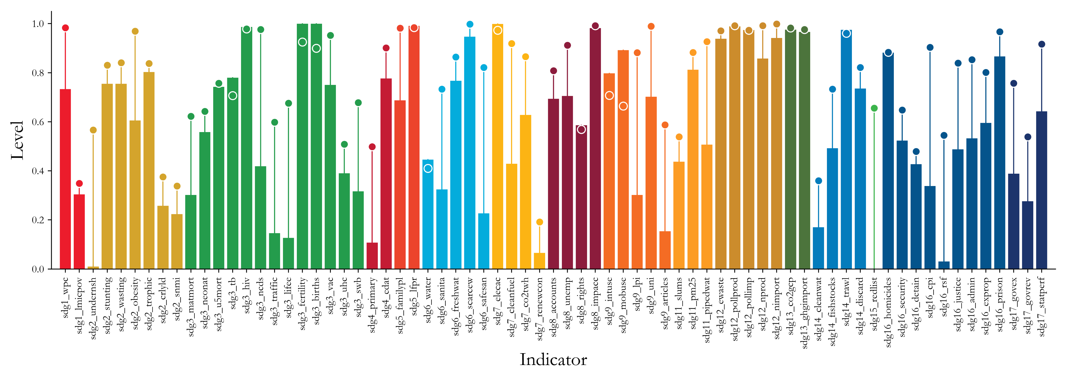
PPI use case: Development gaps
Development gaps: Assess indicators performance against Government’s (random) objectives

Slide 29
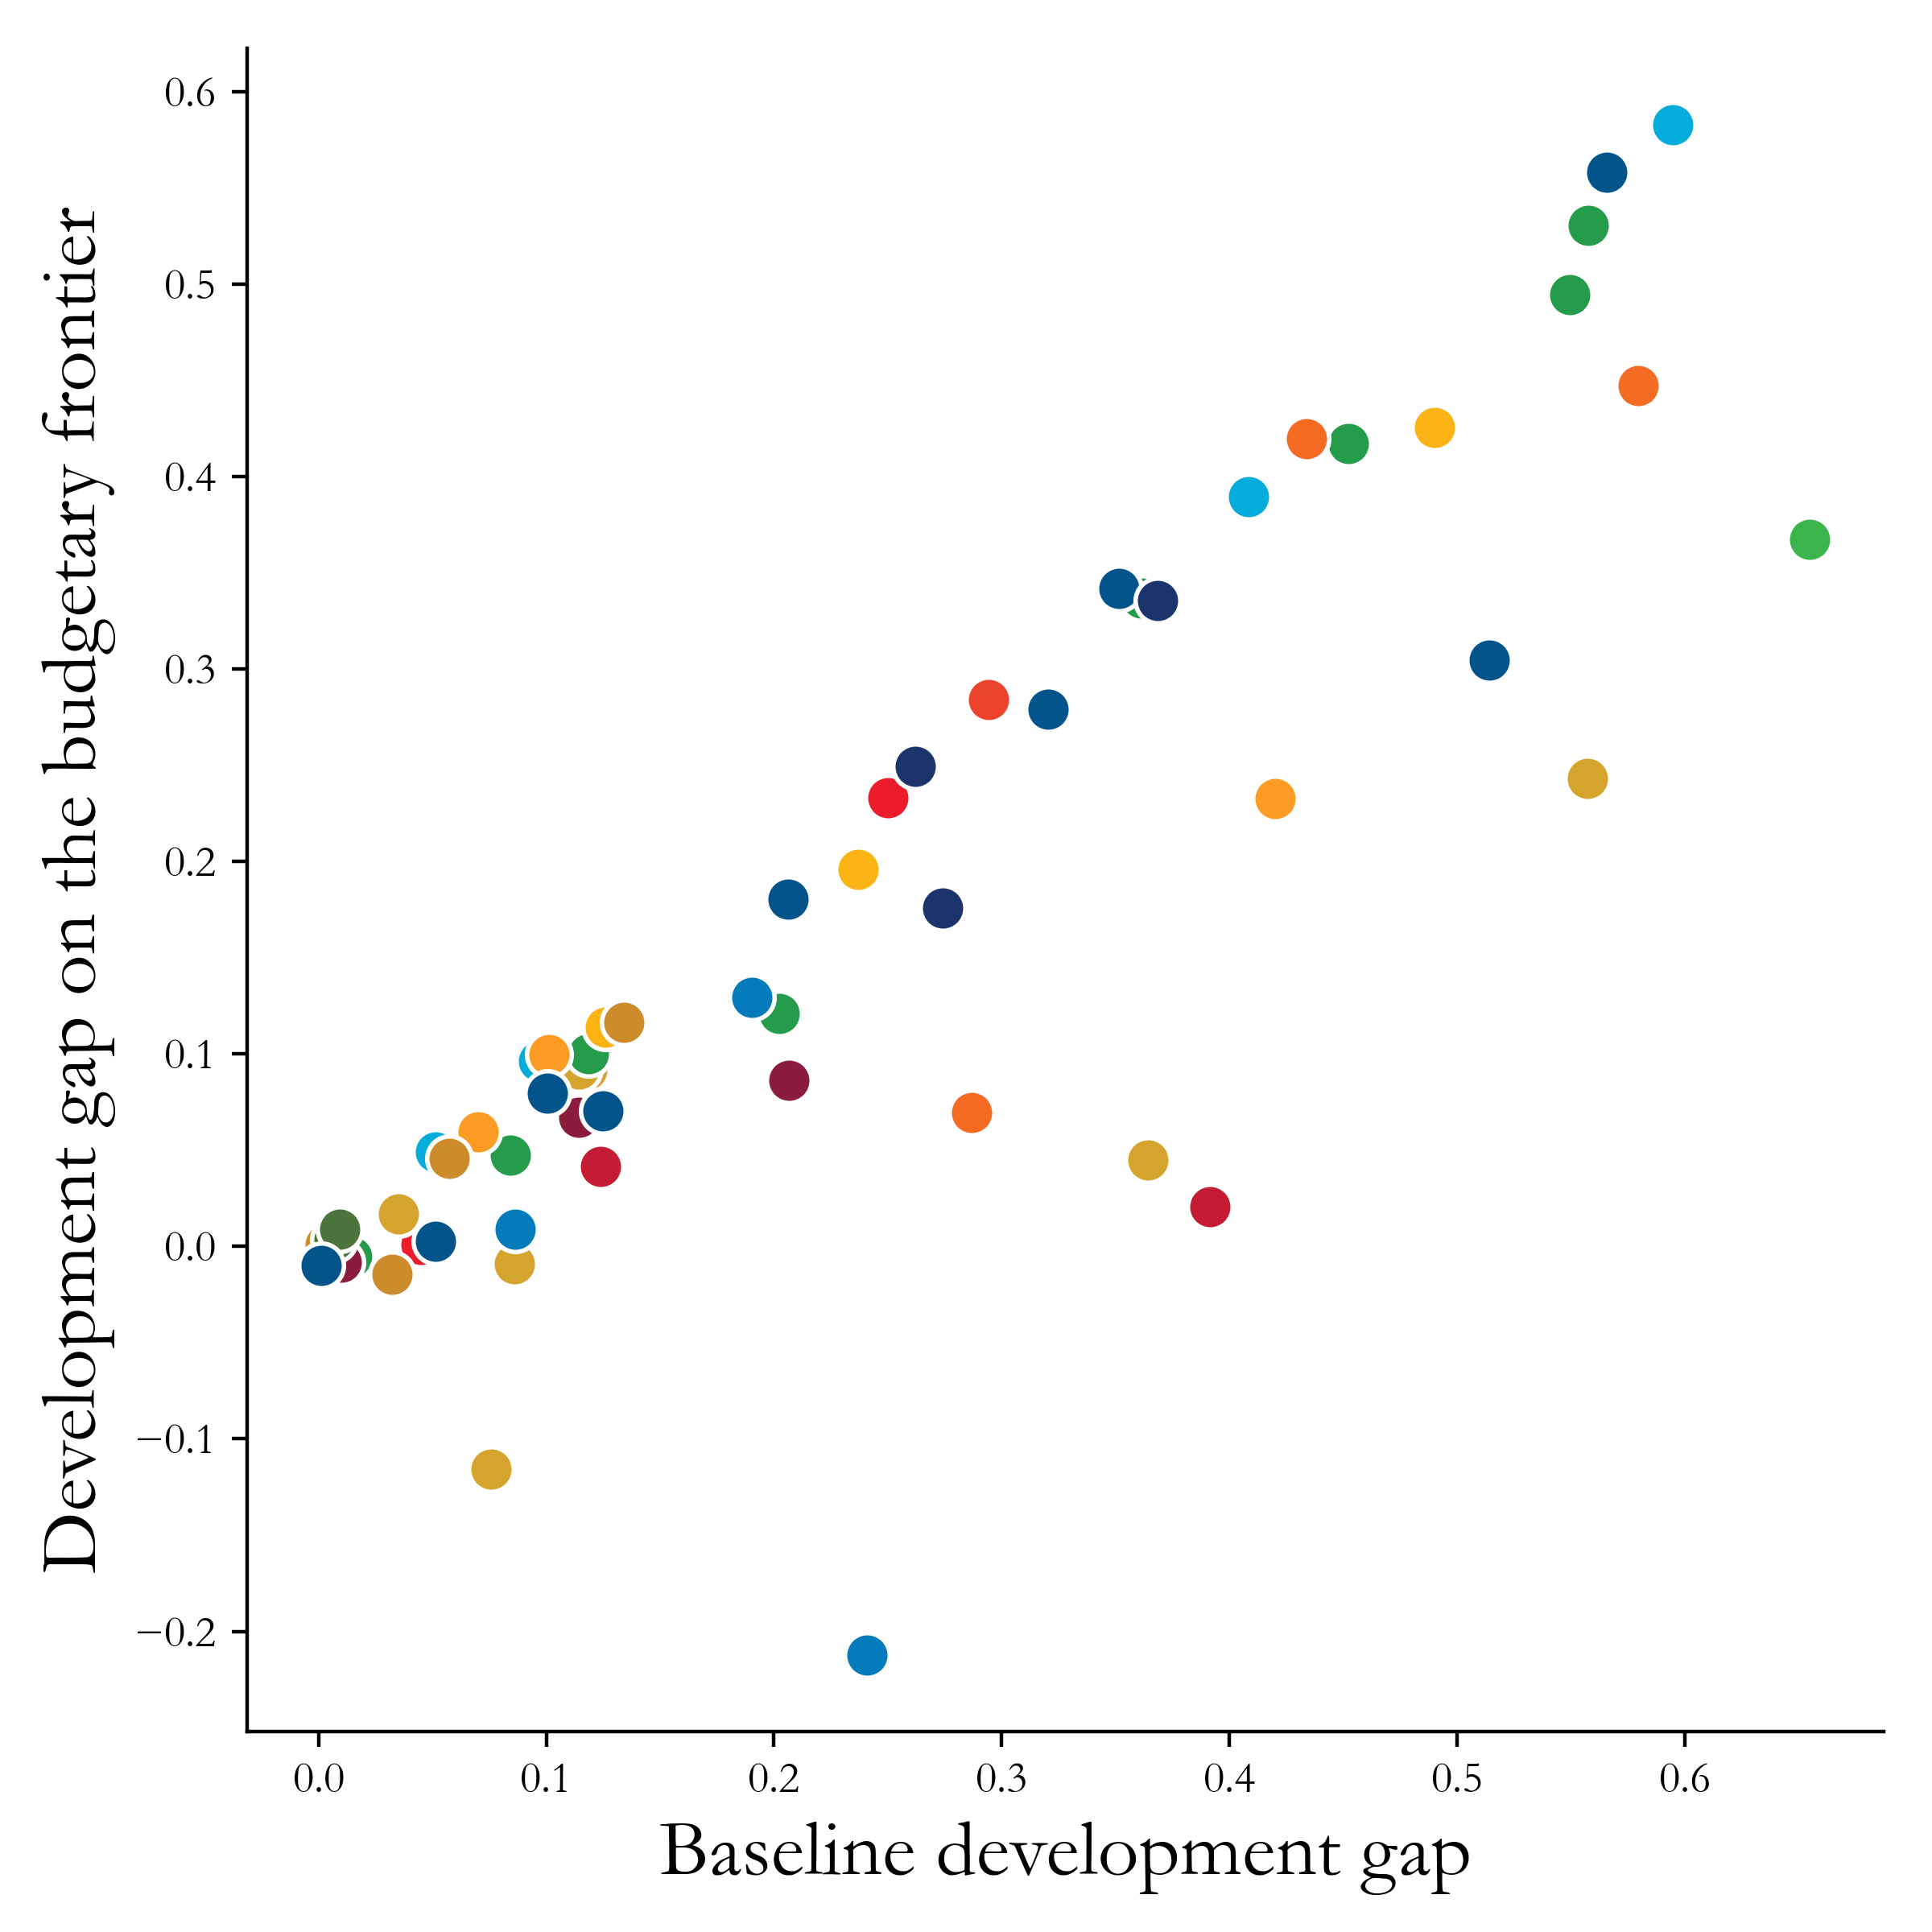
PPI use case: Frontier analysis
Frontier analysis: Hypothetical scenario in which we remove financial constraints

Slide 30
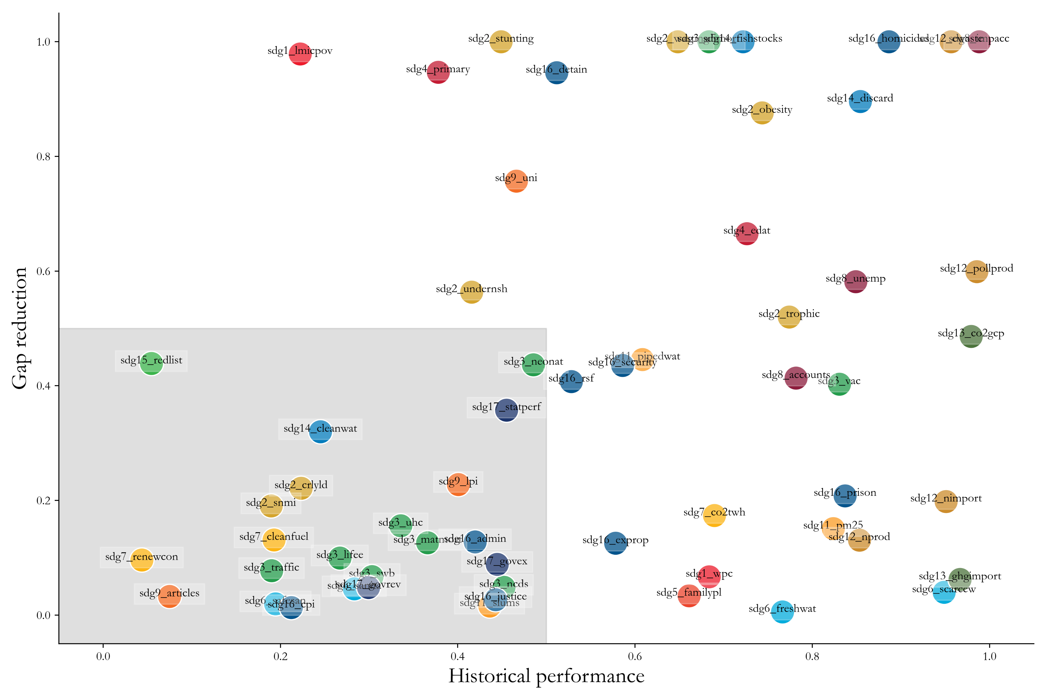
PPI use case: Idiosyncratic bottlenecks
Idiosyncratic bottlenecks: Indicators that have slow historical performance and respond poorly to fiscal interventions

Slide 31

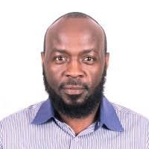
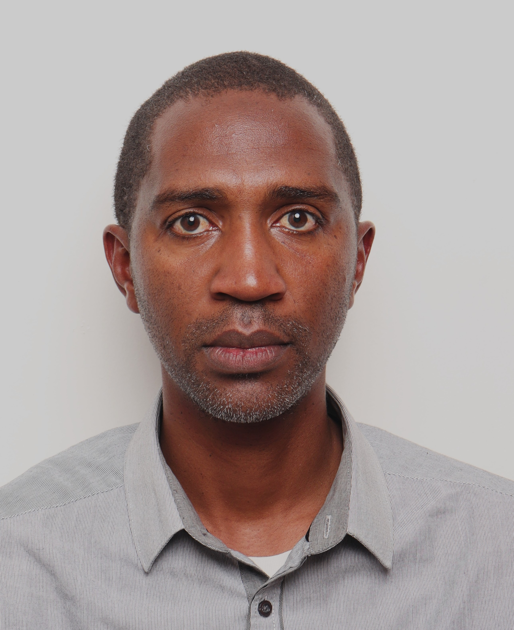
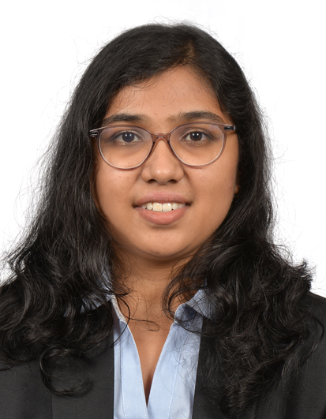
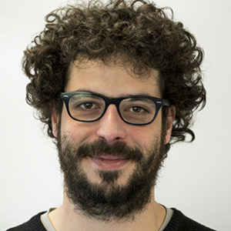


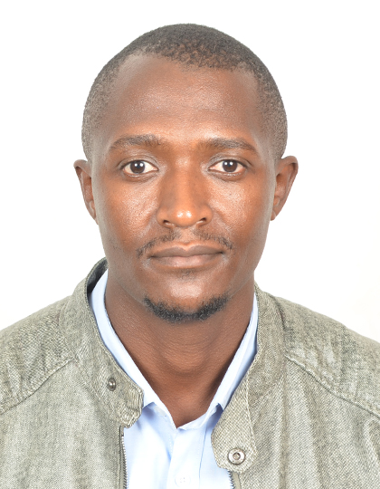
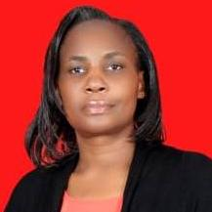
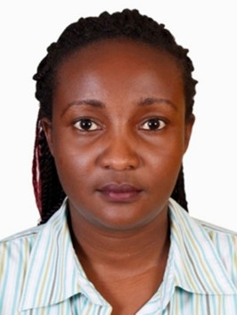

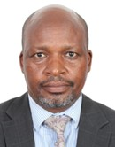
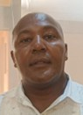
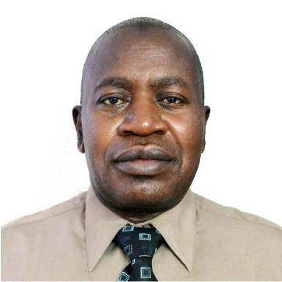
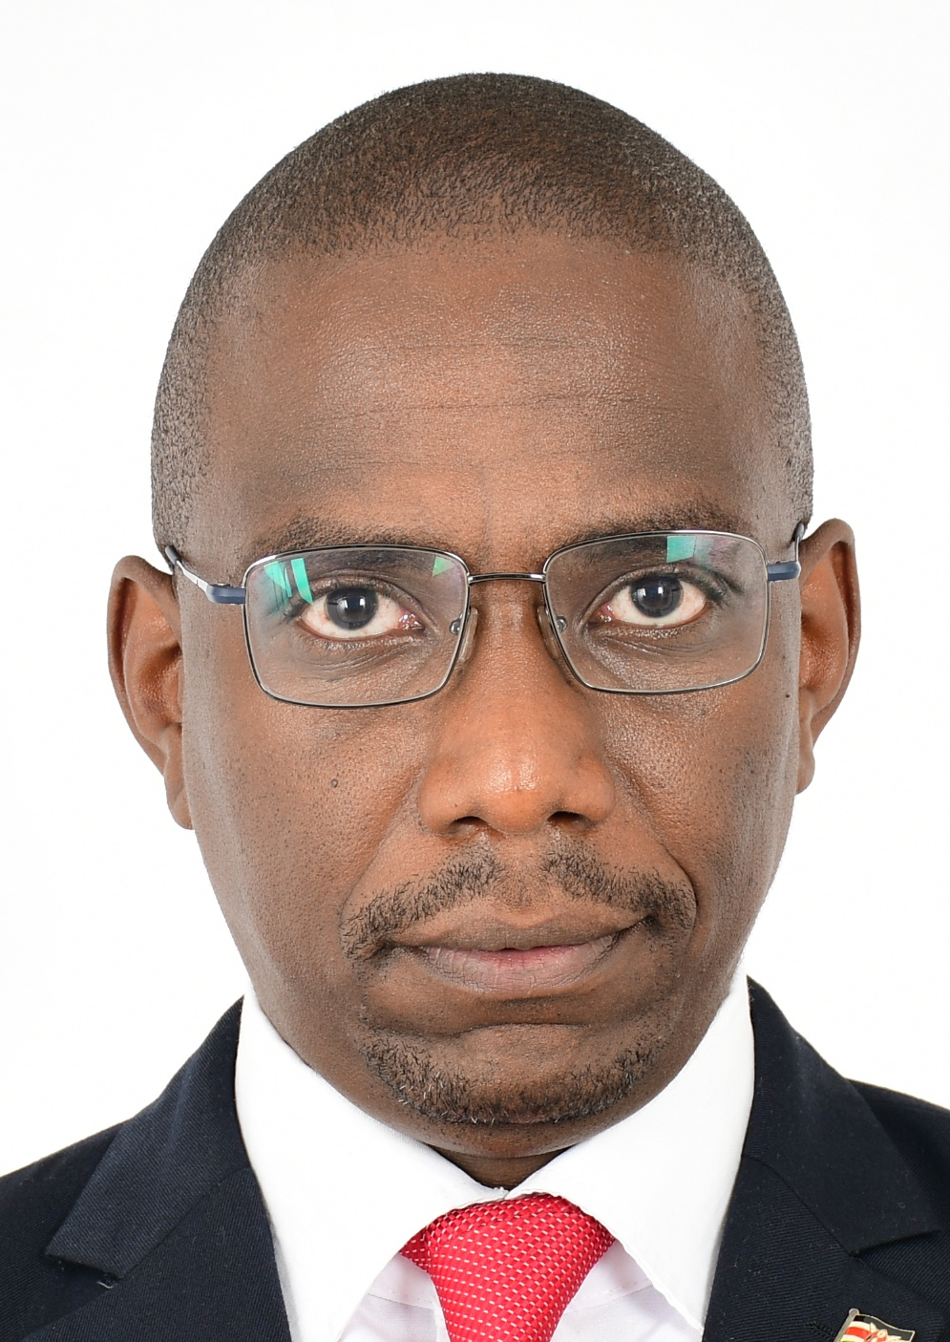
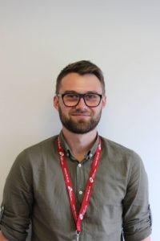
Project Contributors
An international, multidisciplinary and cross-sectoral effort!
Dr Lawrence Nderu JKUAT
Mr Geofrey Kagombe JKUAT
Ms Deepika Ravikrishnan IDS
Dr Marco Carreras
IDS
Dr Omar A. Guerrero
ATI
Dr Daniele Guariso
ATI
Dr Patrick Gikunda
DeKUT
Ms Leah Wambugu KNBS
Ms Linah Ngumba KNBS
Dr Macdonald Obudho KNBS
Mr Benjamin Muchiri KNBS
Mr Hiram Mbatia KNBS
Mr Rajab Mbaruk KNBS
Mr Samuel Wanjau ACTS
Mr Ben Jackson
IDS

Slide 32


Policy Priority Inference (PPI) web app tutorial
A short policy experiment using the Policy Priority Inference (PPI) web application
To run the app: https://policypriority.org/app/
The datasets employed are artificial

Slide 33


Open Discussion
Data gaps identified and best practices to improve data collection and sharing
Role of AI technologies in streamlining/automatizing public financial management processes
Potential barriers to adopting AI-informed analytical tools in decision-making in Kenya
Opportunities to scale the project up on a long-term plan and embed PPI into existing monitoring and evaluation frameworks

Slide 34





A novel LLMs framework: CPUQ
Novel framework based on LLMs: Categorical Perplexity-based Uncertainty Quantification (CPUQ). Three components:
Determining (in)direct relationship existence.
Determining relationship strength.
Determining predictive uncertainty.
It works like a conversation with the model, where we are very careful about:
Prompt Engineering
1) What we ask.
2) How we ask it

Slide 35


Hey CPUQ, time for a quick chat?
Oh, Great CPUQ, keeper of wisdom, what do you know about a potential relationship between program X and indicator Y?
Let me think, …
According to what you have just said, is program X affecting indicator Y?
Well, …
If so, how strong is this effect?
I would say, …

Slide 36



CPUQ highlights
Computational burden manageable.
Convenient for resource-constrained settings.
Open LLMs.
Not a new LLM, but a new way to use them.
Model-agnostic.
Can be fine-tuned through policy-specific expertise
We want humans in the loop!

Slide 37
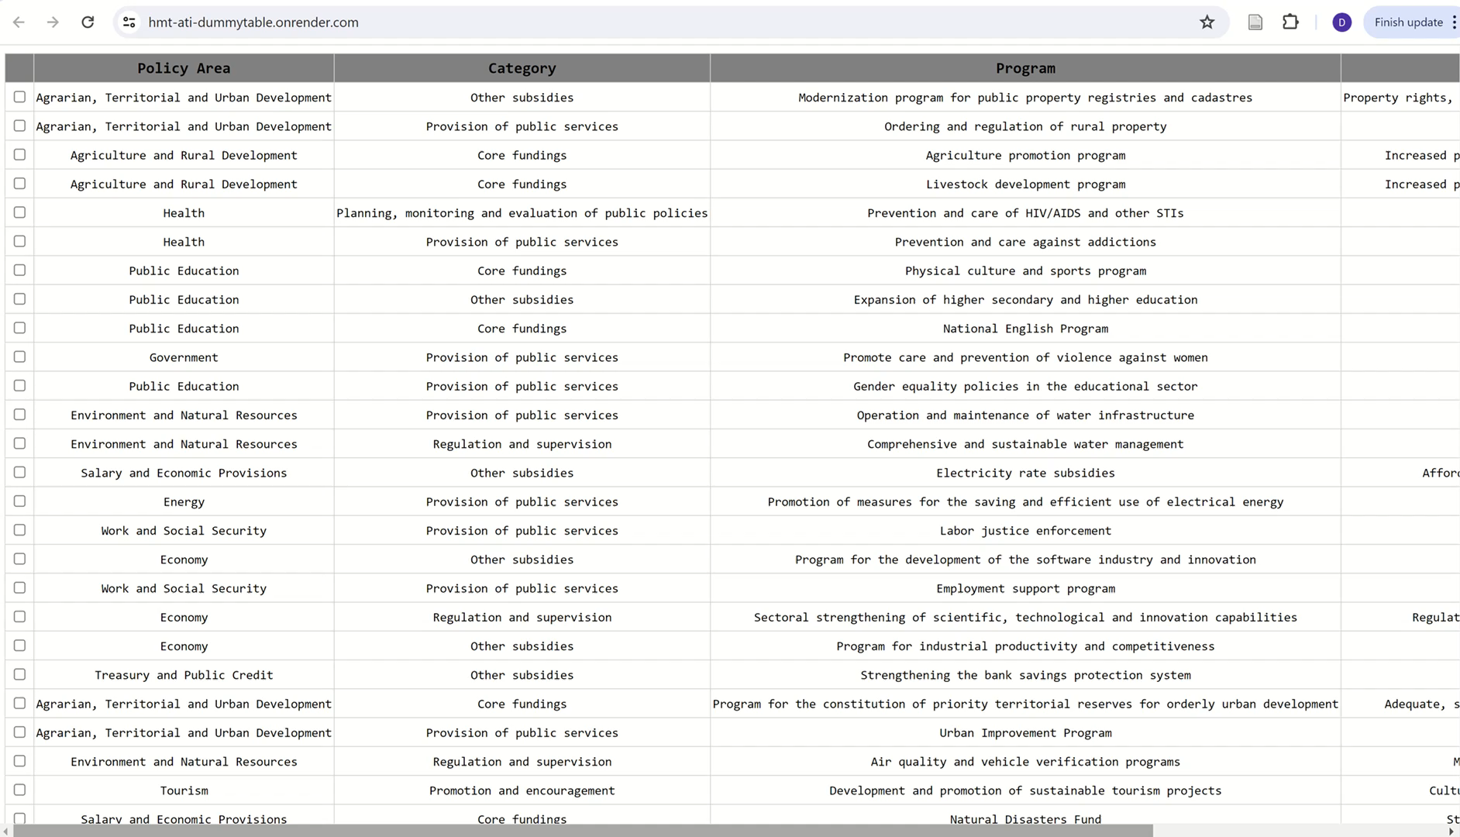
Automatic budget tagging

Slide 38
Thank you!
Are you eager to collaborate? Get in touch!
Dr Daniele Guariso (ATI/IDS):
Email: dguariso@turing.ac.uk / daniele.guariso@gmail.com
Twitter: @DaniGuariso
Mr Rajab K Mbaruku (KNBS):
Email: rmbaruku@knbs.or.ke
Dr Lawrence Nderu (JKUAT):
Email: lnderu@jkuat.ac.ke

